Slide 1
Standing Wave Resonators

Slide 2
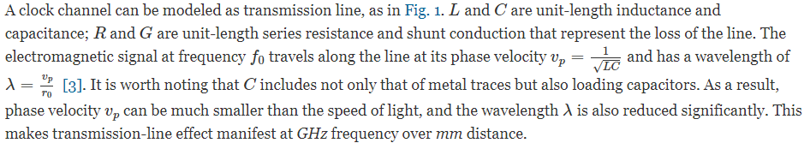
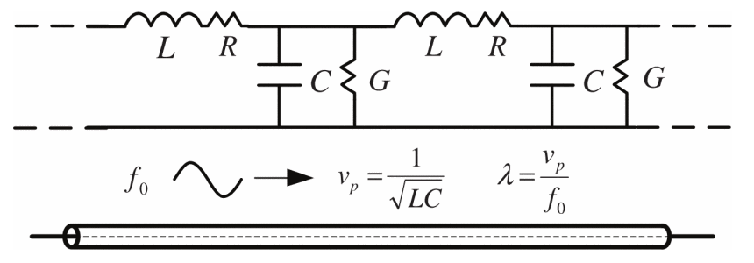
Standing Wave Resonator

Slide 3
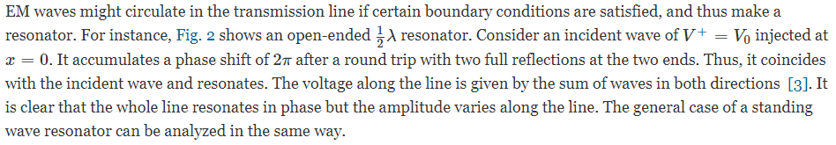
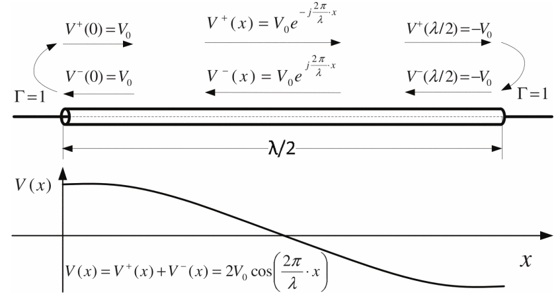
Standing Wave Resonator without Loss

Slide 4
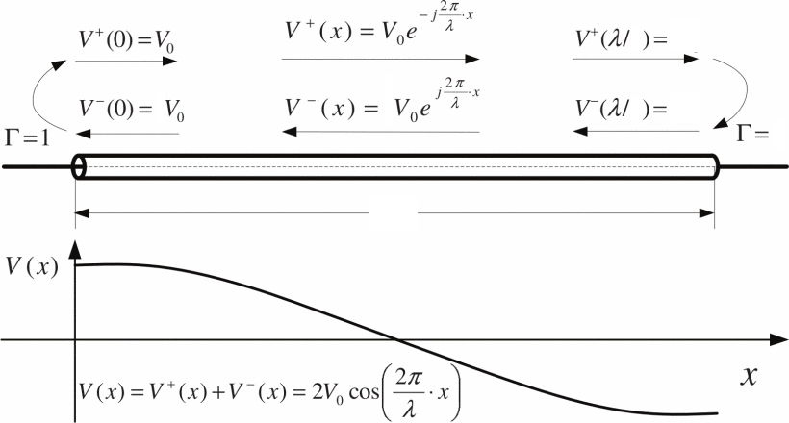
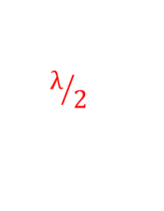


λ/2 Resonator (Open-ended)
2
$${−V}_{0}$$
2
$${−V}_{0}$$
1
$$λ/2$$

Slide 5
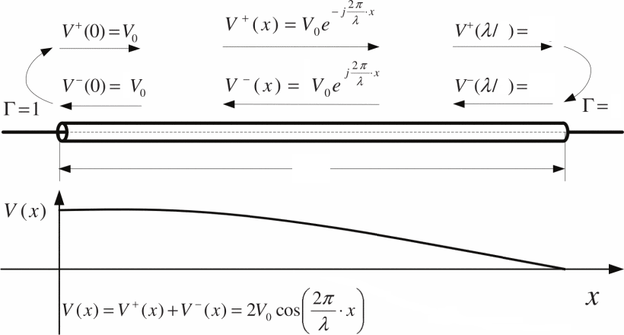

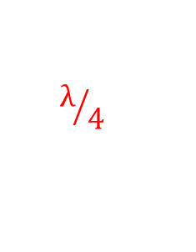

λ/4 Resonator (Short-ended)
4
$$0$$
4
$$0$$
-1
$$λ/4$$

Slide 6
Reference
G. Li, W. Lee, D. Cui, B. Zhang, A. Momtaz and J. Cao, "Standing wave based clock distribution technique with application to a 10 × 11 Gbps transceiver in 28 nm CMOS," 2015 IEEE Asian Solid-State Circuits Conference (A-SSCC), Xiamen, China, 2015, pp. 1-4, doi: 10.1109/ASSCC.2015.7387451. https://ieeexplore.ieee.org/document/7387451

